Slide 1
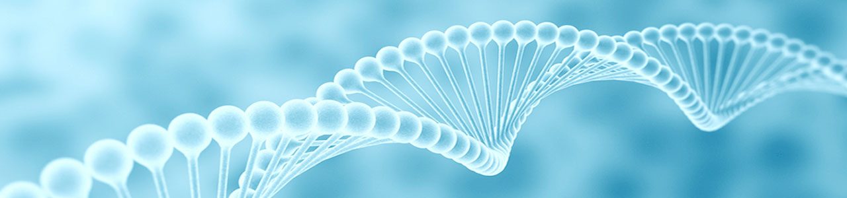
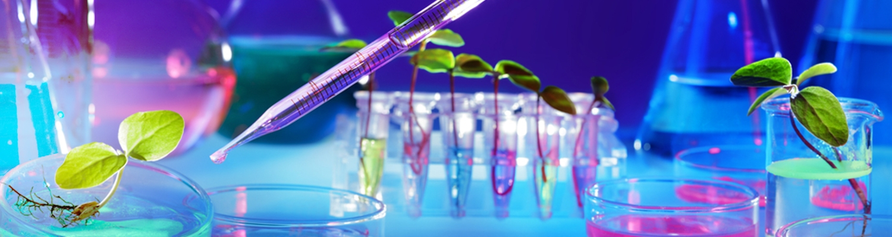
Biotechnology and Microbiology tools & techniques
This Photo by Unknown Author is licensed under CC BY
Dr. Kiran jain
Govt Digvijay PG AUTONOMOUS college
Botany department ,
Rajnandgaon (CG)

Slide 2

1. Biotechnology
Biotechnology is the integration of natural science and organisms, cells parts thereof, molecular analogues for products and services.Two core branches of biotechnology : 1. genetic engineering; Application in treatment of many
Disease like cancer and other genetical disorders. Recombinant DNA
Production of microorganism in large scale and keep environment contamination free, examples vaccines and antibiotics
This Photo by Unknown Author is licensed under CC BY-NC-ND

Slide 3
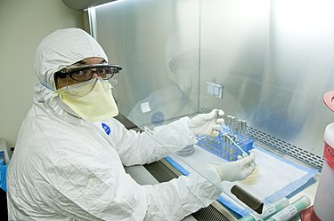
Microbiology
Study of microorganism and their relation with plants, enviornments and Animals (humans).
It deals with complexity of cultivating microorganism to also prevent the contamination by sterilization process
Microbiology deals with study of microorganisms and biotechnology deals with the techniques of producing and introducing the microorganism, genes technology for human and plants uses.
Hence we can say that it modifies the biological functions of organism by adding genes from another organisms.

Slide 4
STERILIZATION
All the apparatus and growth mediums used to cultivate the organisms should be free from any forms of life. This is achieved by sterilization process which either kill the organisms or stops the cycle of growth .
Two types of Sterilization process : 1.Physical method 2.Chemical method.
1. Dry heat
2. Incineration
3. Moist heat
4. Ozone
5. Filteration

Slide 5
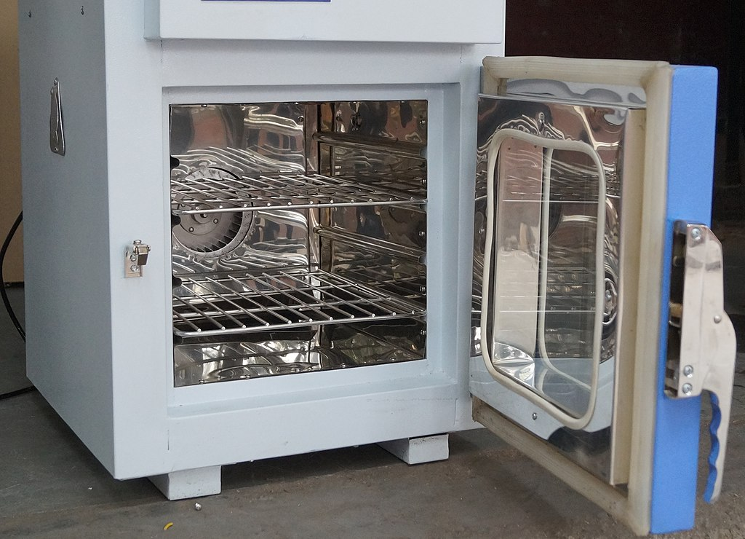
HOT AIR OVEN
Hot air oven is an equipment used for sterilization of glassware, metal devices, oil containing material, powder and other articles which cannot be sterilized by autoclaving etc.
Principle : Dry heat is used for sterilization process. The heat precipitate the protein of microorganisms and hence it kills them.
Heat gets uniformly distributed in surface then in centre .
This Photo by Unknown Author is licensed under CC BY-SA

Slide 6
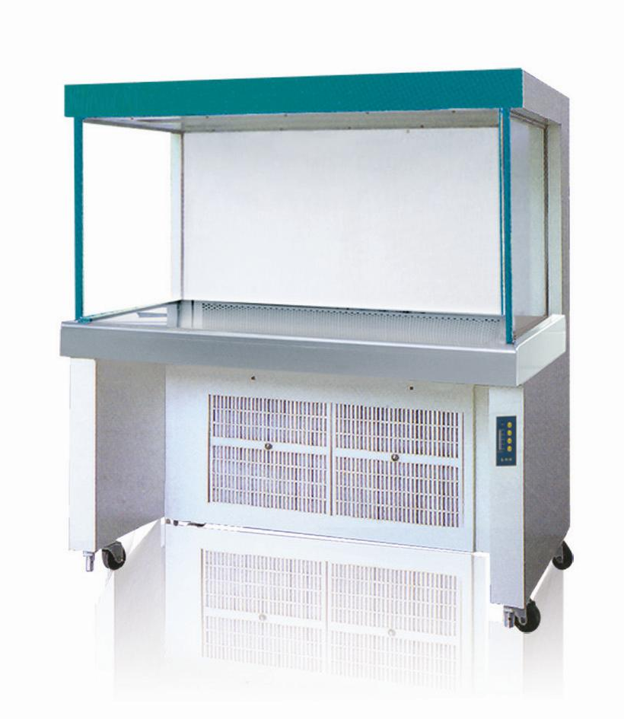
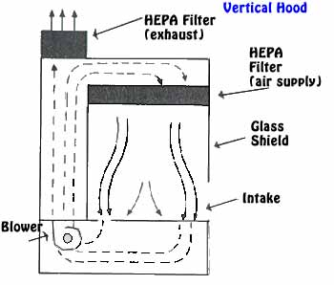
Laminar Air Flow
A Laminar flow cabinet is an enclosed workstation that is used to create a contamination free work environment through filters (HEPA) to capture all the particles entering the cabinet.
The principle of laminar flow cabinet is based on the laminar flow of air through the cabinet
The device works by the use of inwards flow of air through one or more HEPA filters to create a particulate-free environment.
Y

Slide 7
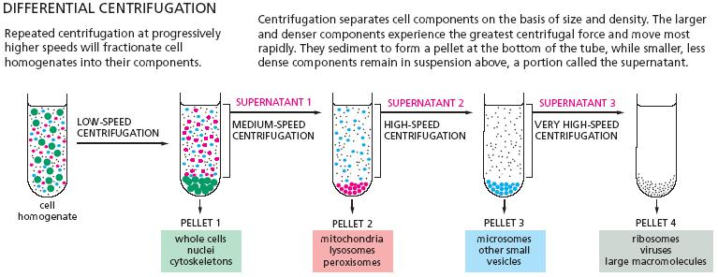
Centrifugation
Centrifugation is the process that separate or concentrate materials suspended in a liquid medium. It involves the use of centrifugal force.
Principle : suspeneded in solution are pulled downwords by earth’s gravitational force. In a solution, particles whose mass or density is higher than that of the solvent sink or sediments, and lighter particles float on the top.
The greater the difference in mass or density, the faster they sink.
Application : separating plasma from blood and also useful in extraction of fats from milk
Basically miscible liquids can be separated by this techniques

Slide 8
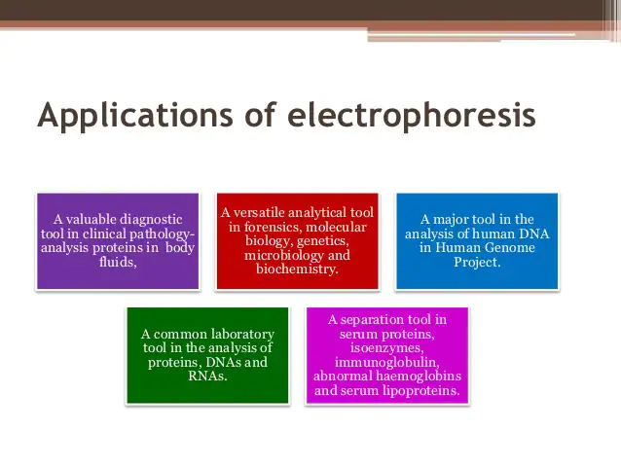
Electrophoresis
Electrophoresis is a laboratory technique used to separate DNA, RNA, or protein molecules based on their size and electrical charge. An electric current is used to move molecules to be separated through a gel.
Techniques is based on the mobility of ions in an electric field .ions have different migration rates depends on their size, change and shape and can therefore separated

Slide 9
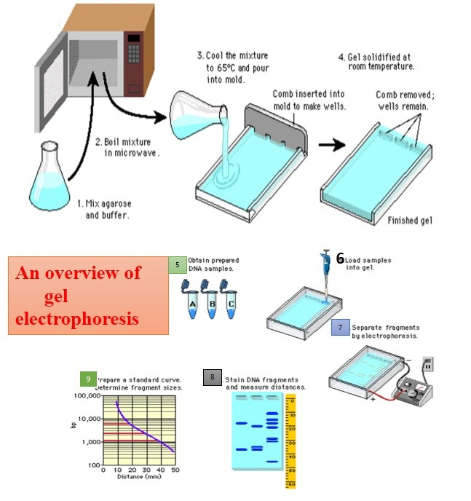

Slide 10
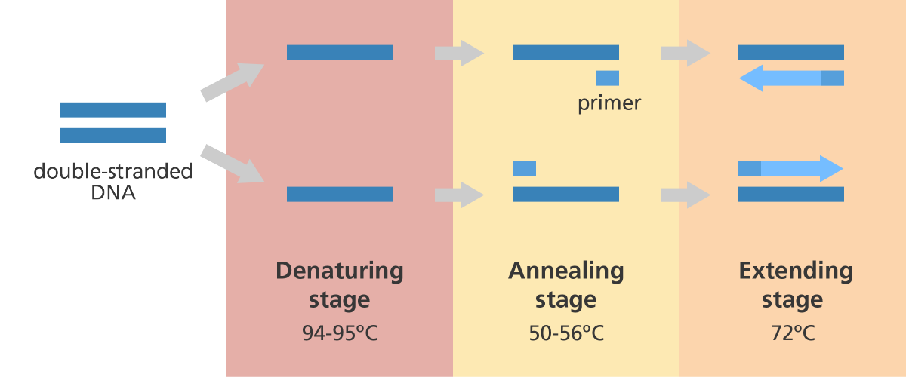
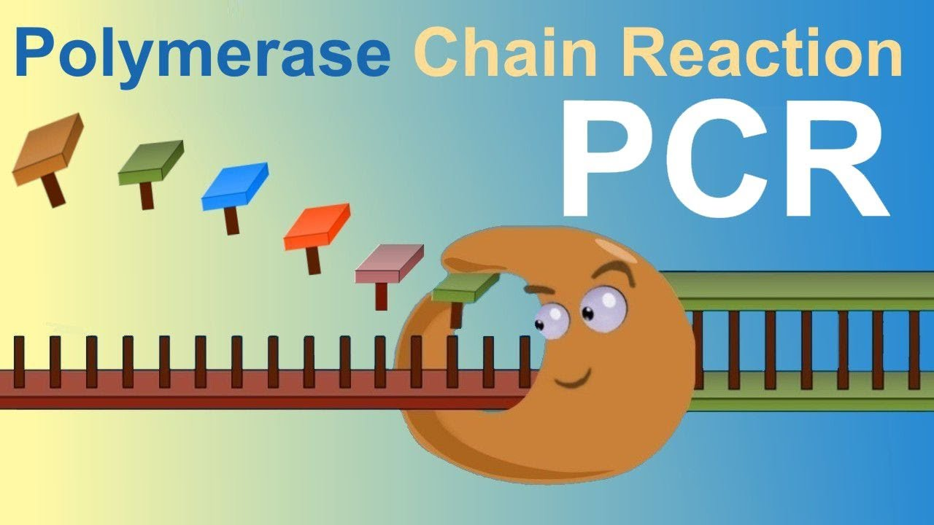
Polymerase chain reactions
PCR is a laboratory techniques for generating large quantity of a specified DNA for synthesizing multiple identucles copy of DNA.

Slide 11
PCR continue..
PCR involves a process of heating and cooling called thermal cycling which is carried out by machine.
There are three main stages:
  Denaturing – when the double-stranded template DNA is heated to separate it into two single strands.
  Annealing – when the temperature is lowered to enable the DNA primers to attach to the template DNA.
  Extending – when the temperature is raised and the new strand of DNA is made by the Taq polymerase enzyme.
These three stages are repeated 20-40 times, doubling the number of DNA copies each time.
A complete PCR reaction can be performed in a few hours, or even less than an hour with certain high-speed machines.
After PCR has been completed, a method called electrophoresis can be used to check the quantity and size of the DNA fragments produced.

Slide 12
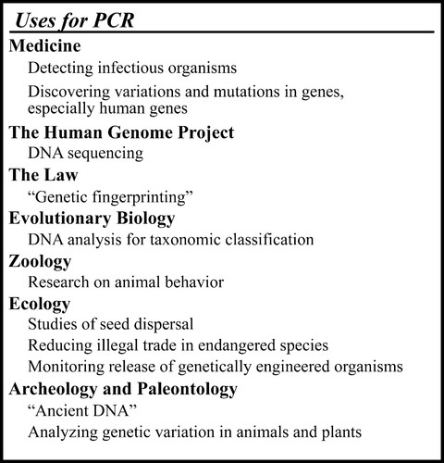
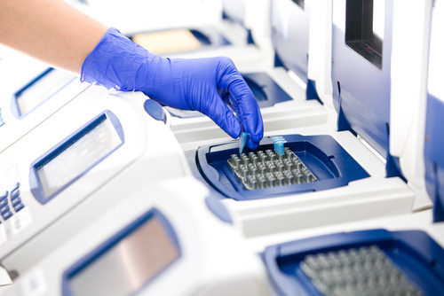
Application of PCR

Slide 13
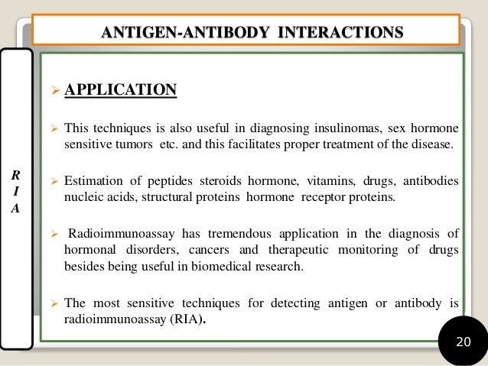
Immuno-techniques
Radioimmunoassay (RIA) and Enzyme-Linked Immunosorbent Assay (ELISA) are both laboratory techniques that use antigen-antibody reactions to detect and measure substances like hormones, drugs, proteins, and tumor markers in biological samples.

Slide 14
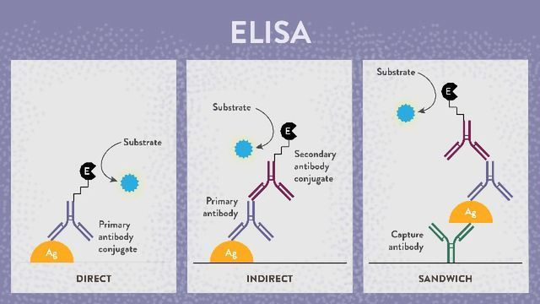
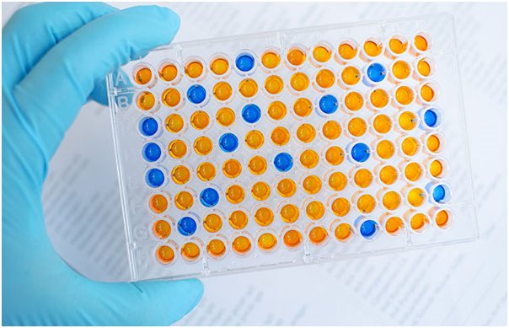

Slide 15
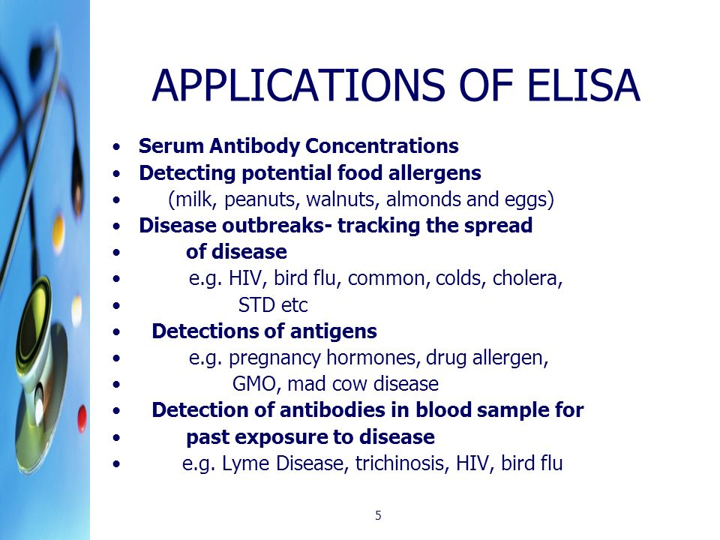
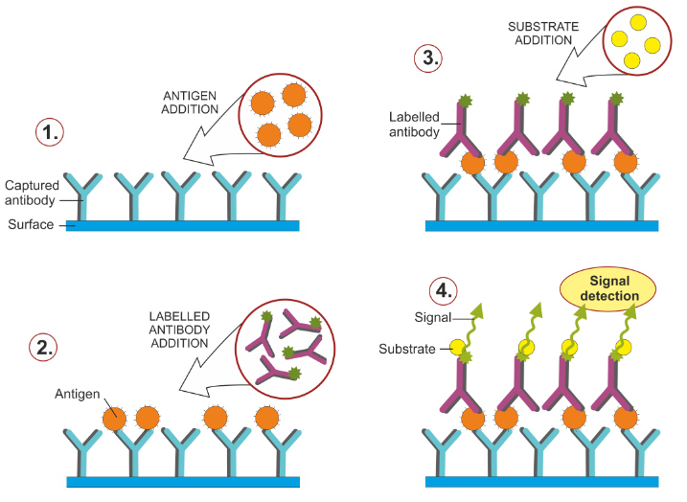

Slide 16
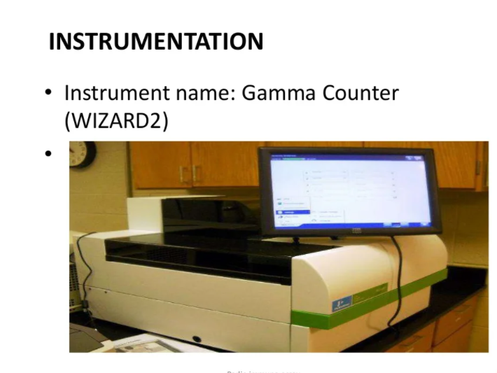
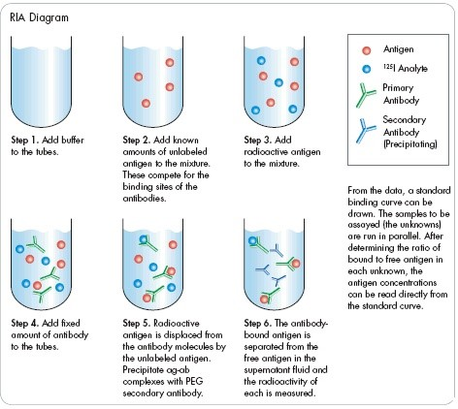
RIA

Slide 17
Acknowledgement
Thank you everyone And botany department

